Slide 1



Creating Open Knowledge Graph for Climate
Shweata Hegde and #sC Team
2025-02-15
@shweataHegde
Shweata N. Hegde
https://semanticclimate.github.io/p/en/

Slide 2
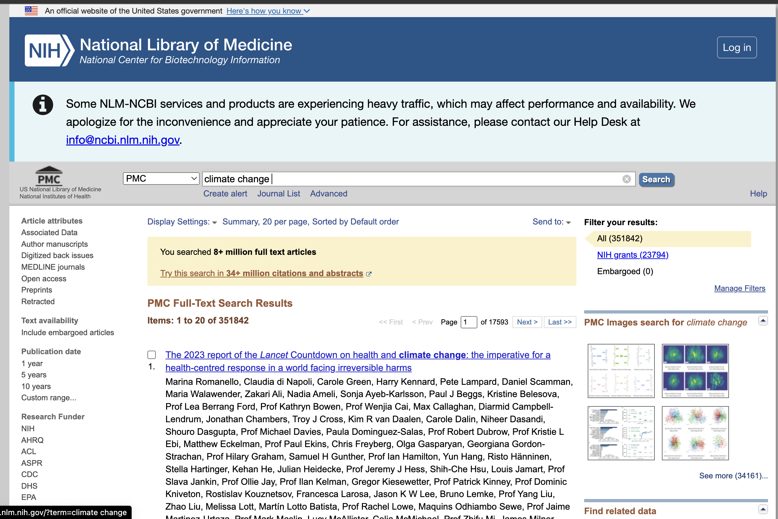
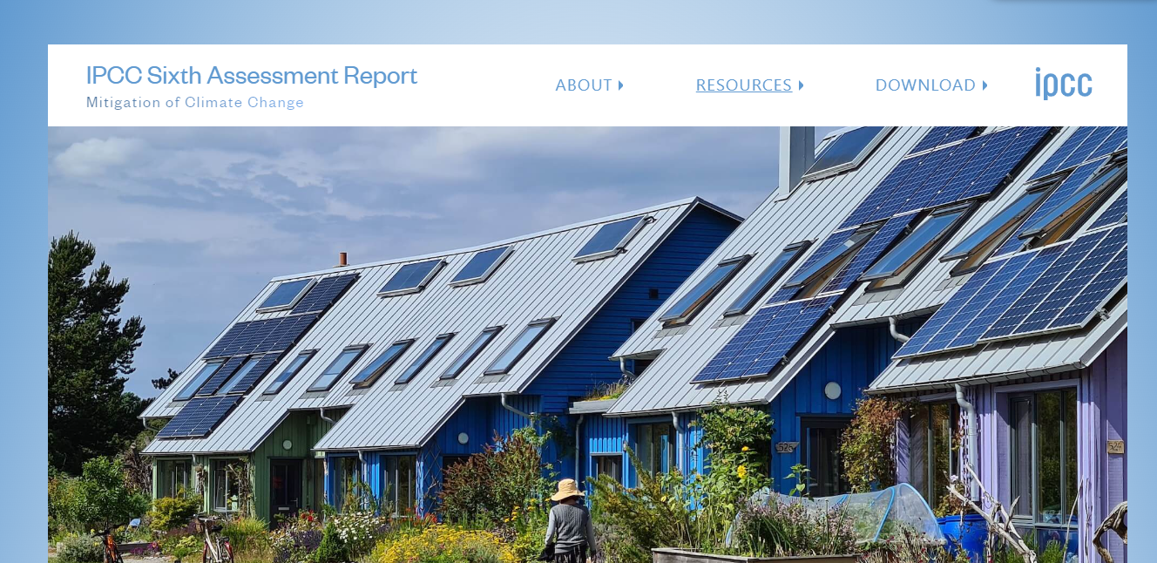
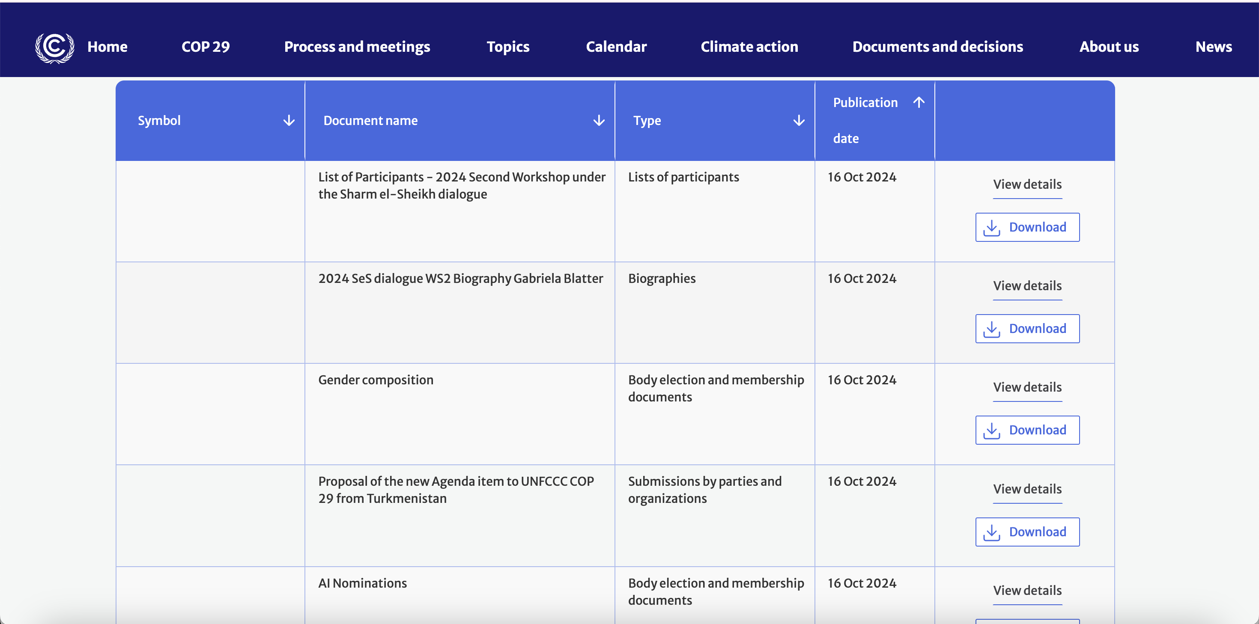

So much climate knowledge!
IPCC Reports
(10000+ pages)
UNFCCC Documents
(1000 Pages)
Scientific literature

Slide 3

PDFs are not sustainable (1-star); knowledge locked up; cause massive wastage
< >
Scraped
HTML
IPCC Reports
(10000+ pages)
UNFCCC Documents
(1000 pages)

Slide 4

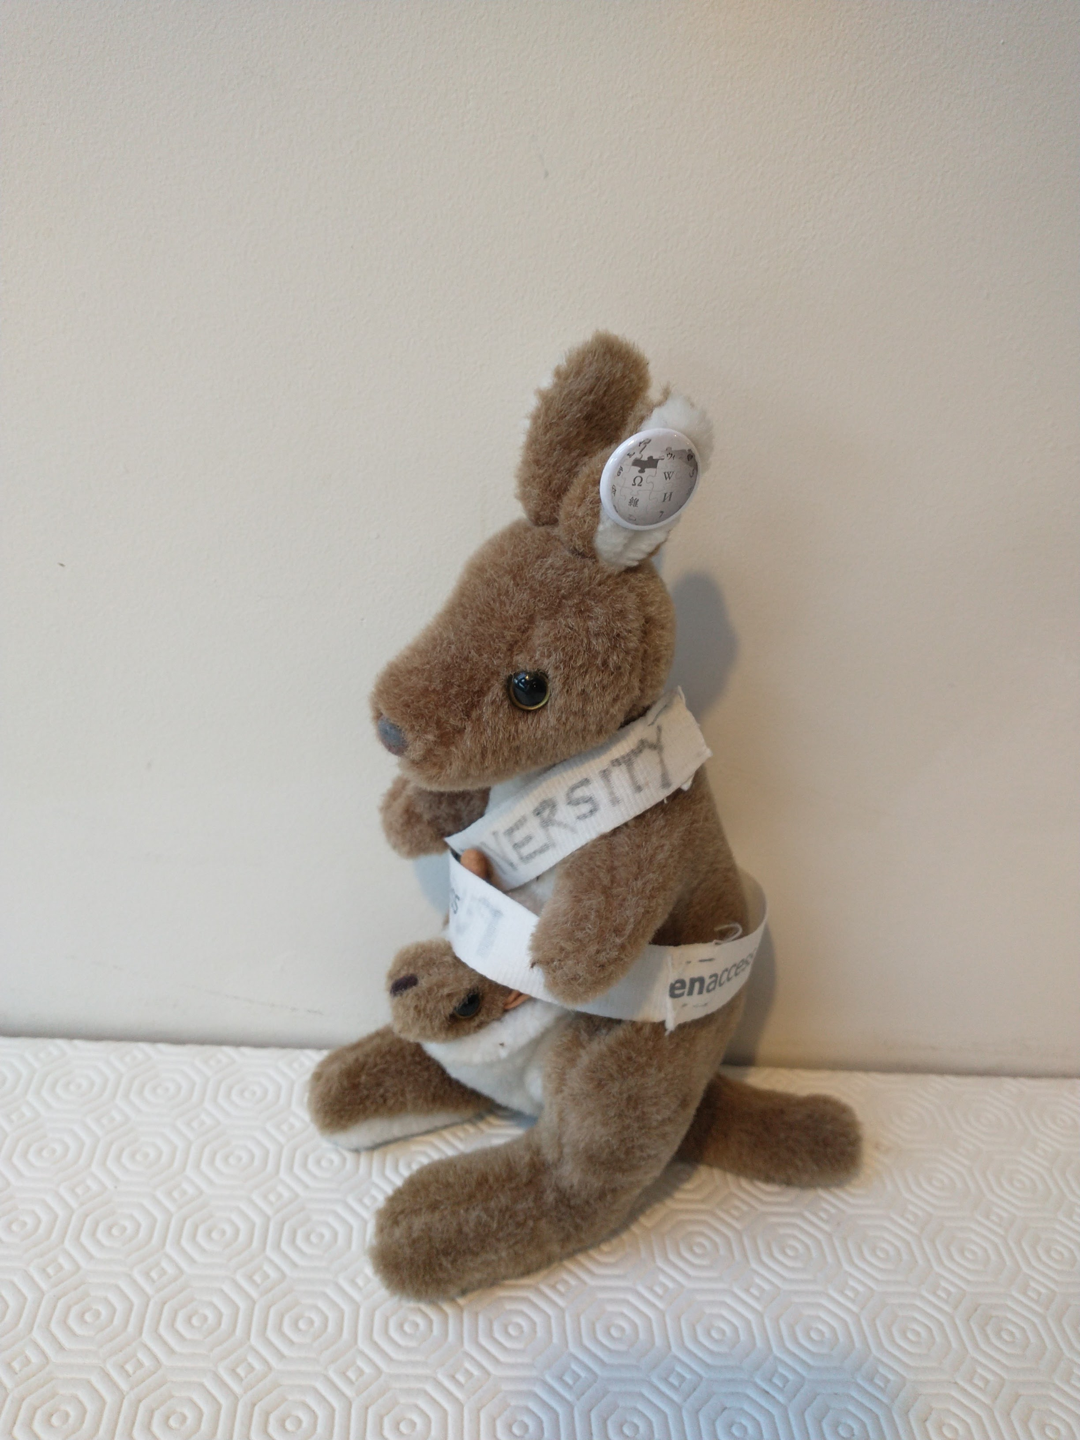
You’ve come to the right person, Chuff. I can turn the PDFs into a semantic 5-star documents so the knowledge is usable
AMI, need your help. What do we do with these PDF?

Slide 5
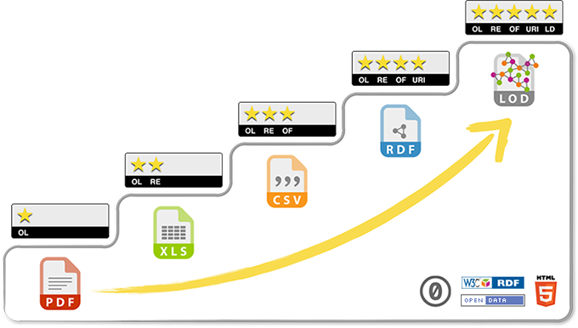
What Do We Mean by 5-star Document?
5-star: Semantic HTML + Unique Identifiers + Annotation
Tim Berners-Lee’s Classification

Slide 6
Our Mission
To create verifiable computable climate knowledge (5-star-documents)
we take the following as verifiable sources of truth
IPCC framework (PDF or web-HTML)
UNFCCC reports (COPs)
1000/week scholarly climate publications

Slide 7
Framework of IPCC Reports
Reports
3 Working Groups (WG1, WG2, WG3)
Several Special Reports
Synthesis Report
20,000 pages of PDF => HTML
1000 figure captions
15000+ bibliography
700-term Glossary
1500 acronyms
We make all these semantic (machine parsable into structured, annotated data).

Slide 8
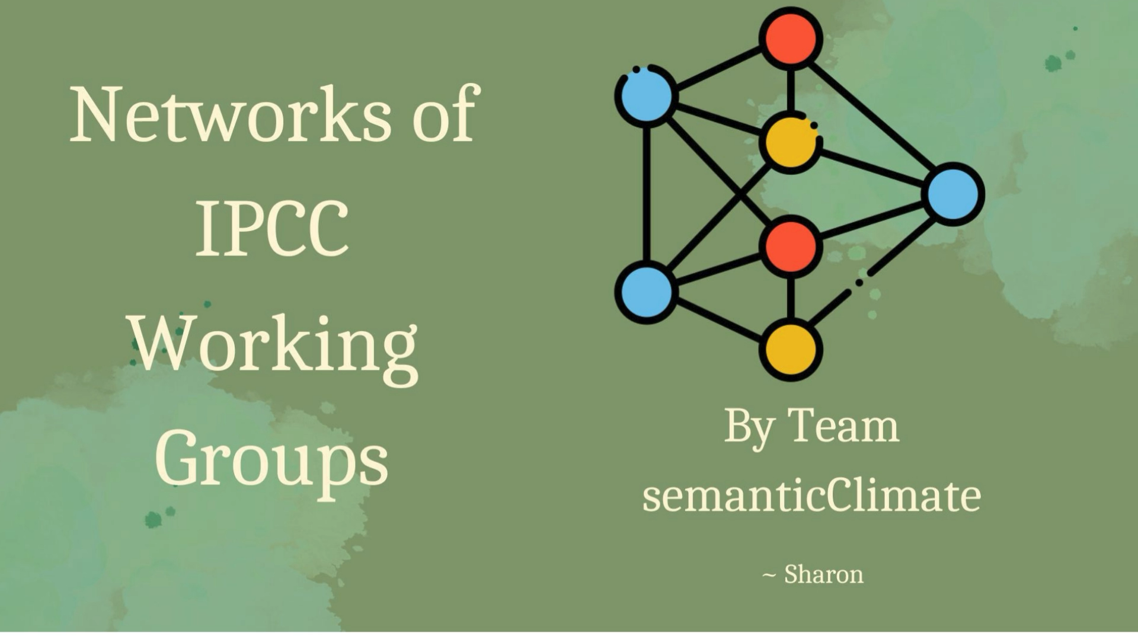
Climate Knowledge Graph

Slide 9
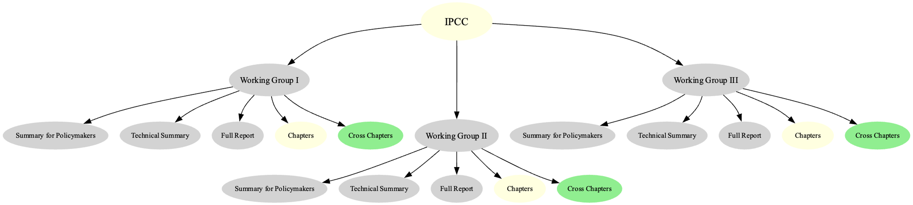
#semanticClimate’s IPCC Knowledge Graph (HTML and SVG)
Anudev, Shabnam and Sharon (Present Interns)

Slide 10
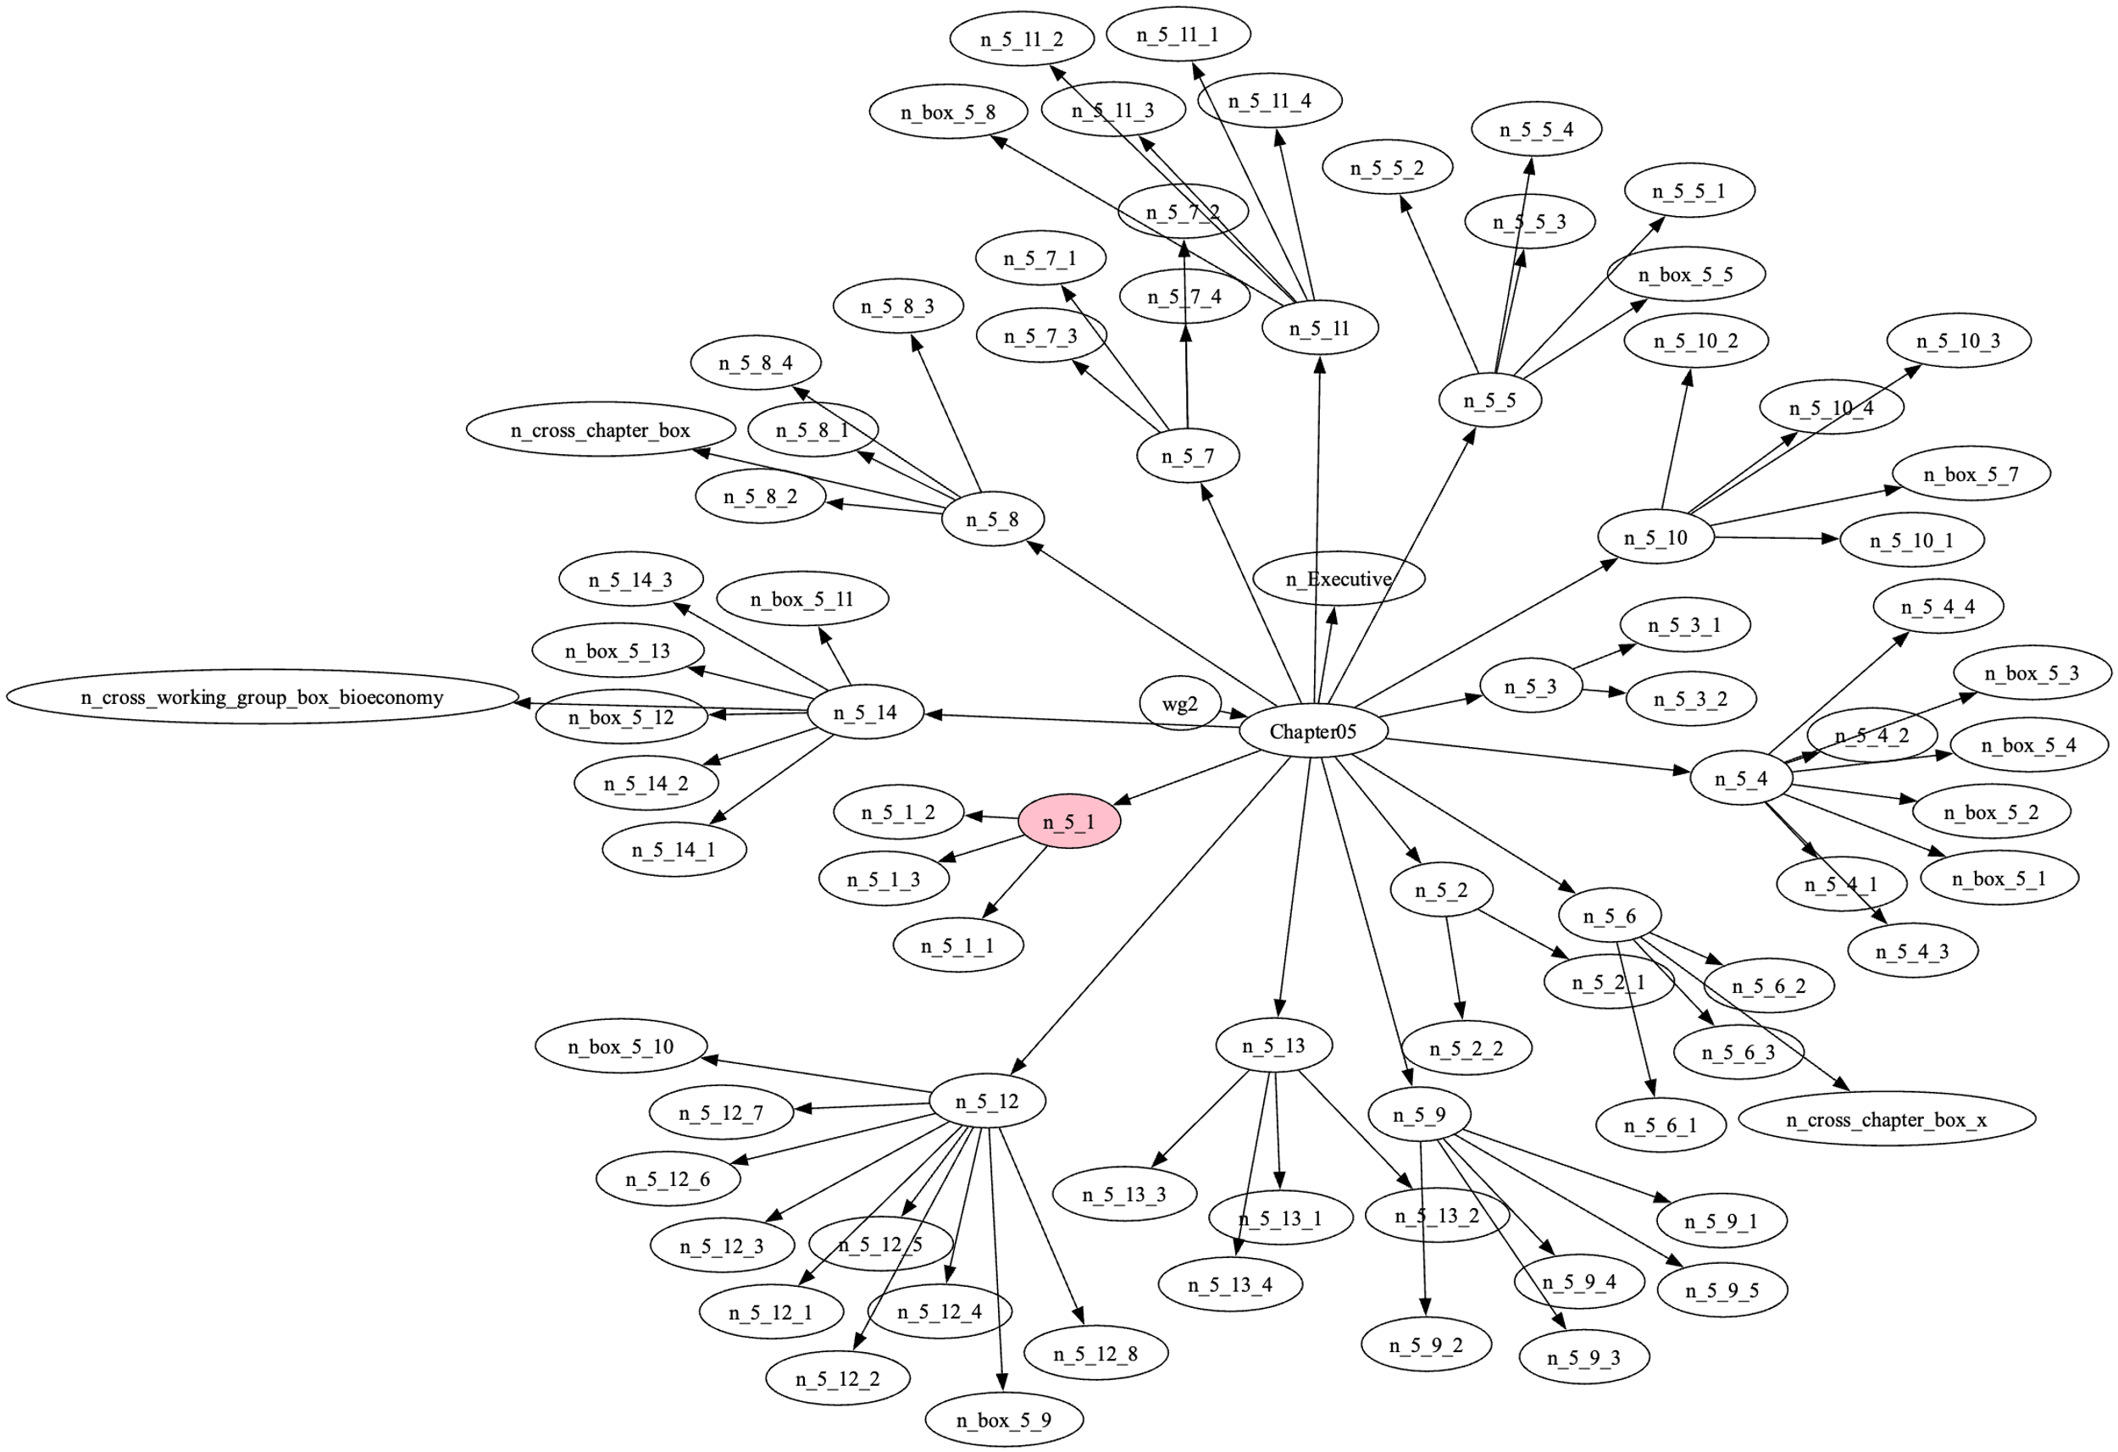
Knowledge Graph of WG2/Chapter 05
https://raw.githubusercontent.com/petermr/amilib/refs/heads/pmr_aug/temp/ipcc/wg2/Chapter05/toc.fdp.svg

Slide 11
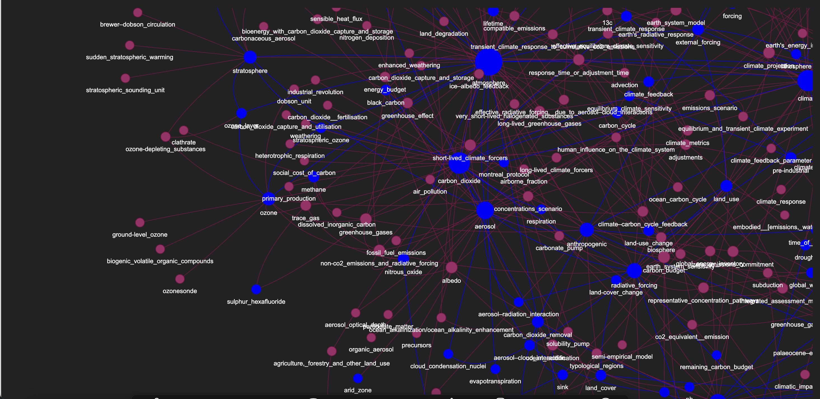
Glossary Knowledge Graph
IPCC Glossary

Slide 12
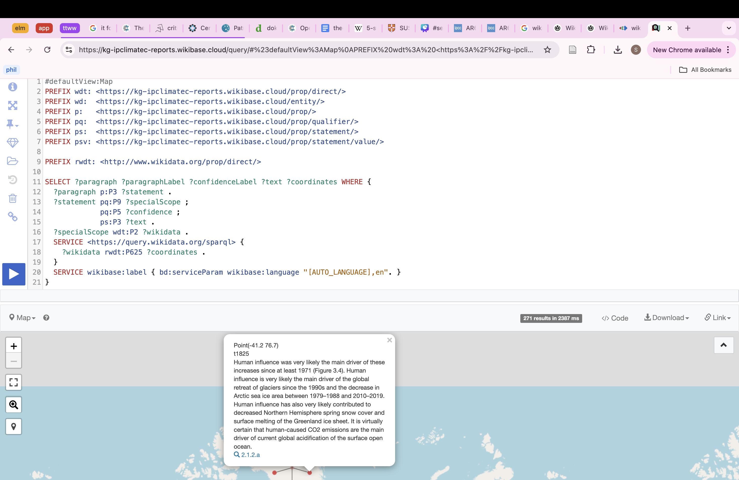
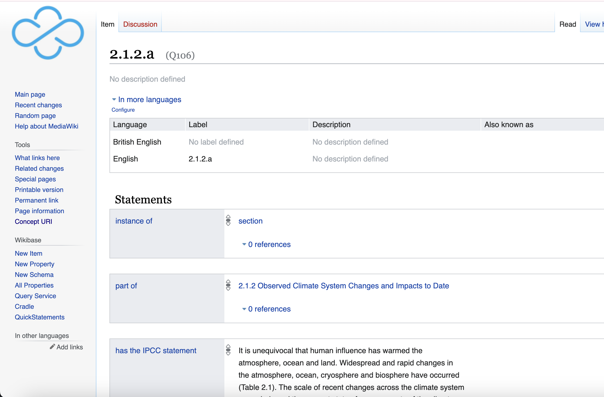
Wikibase for Climate Knowledge
https://kg-ipclimatec-reports.wikibase.cloud/wiki/Item:Q106

Slide 13
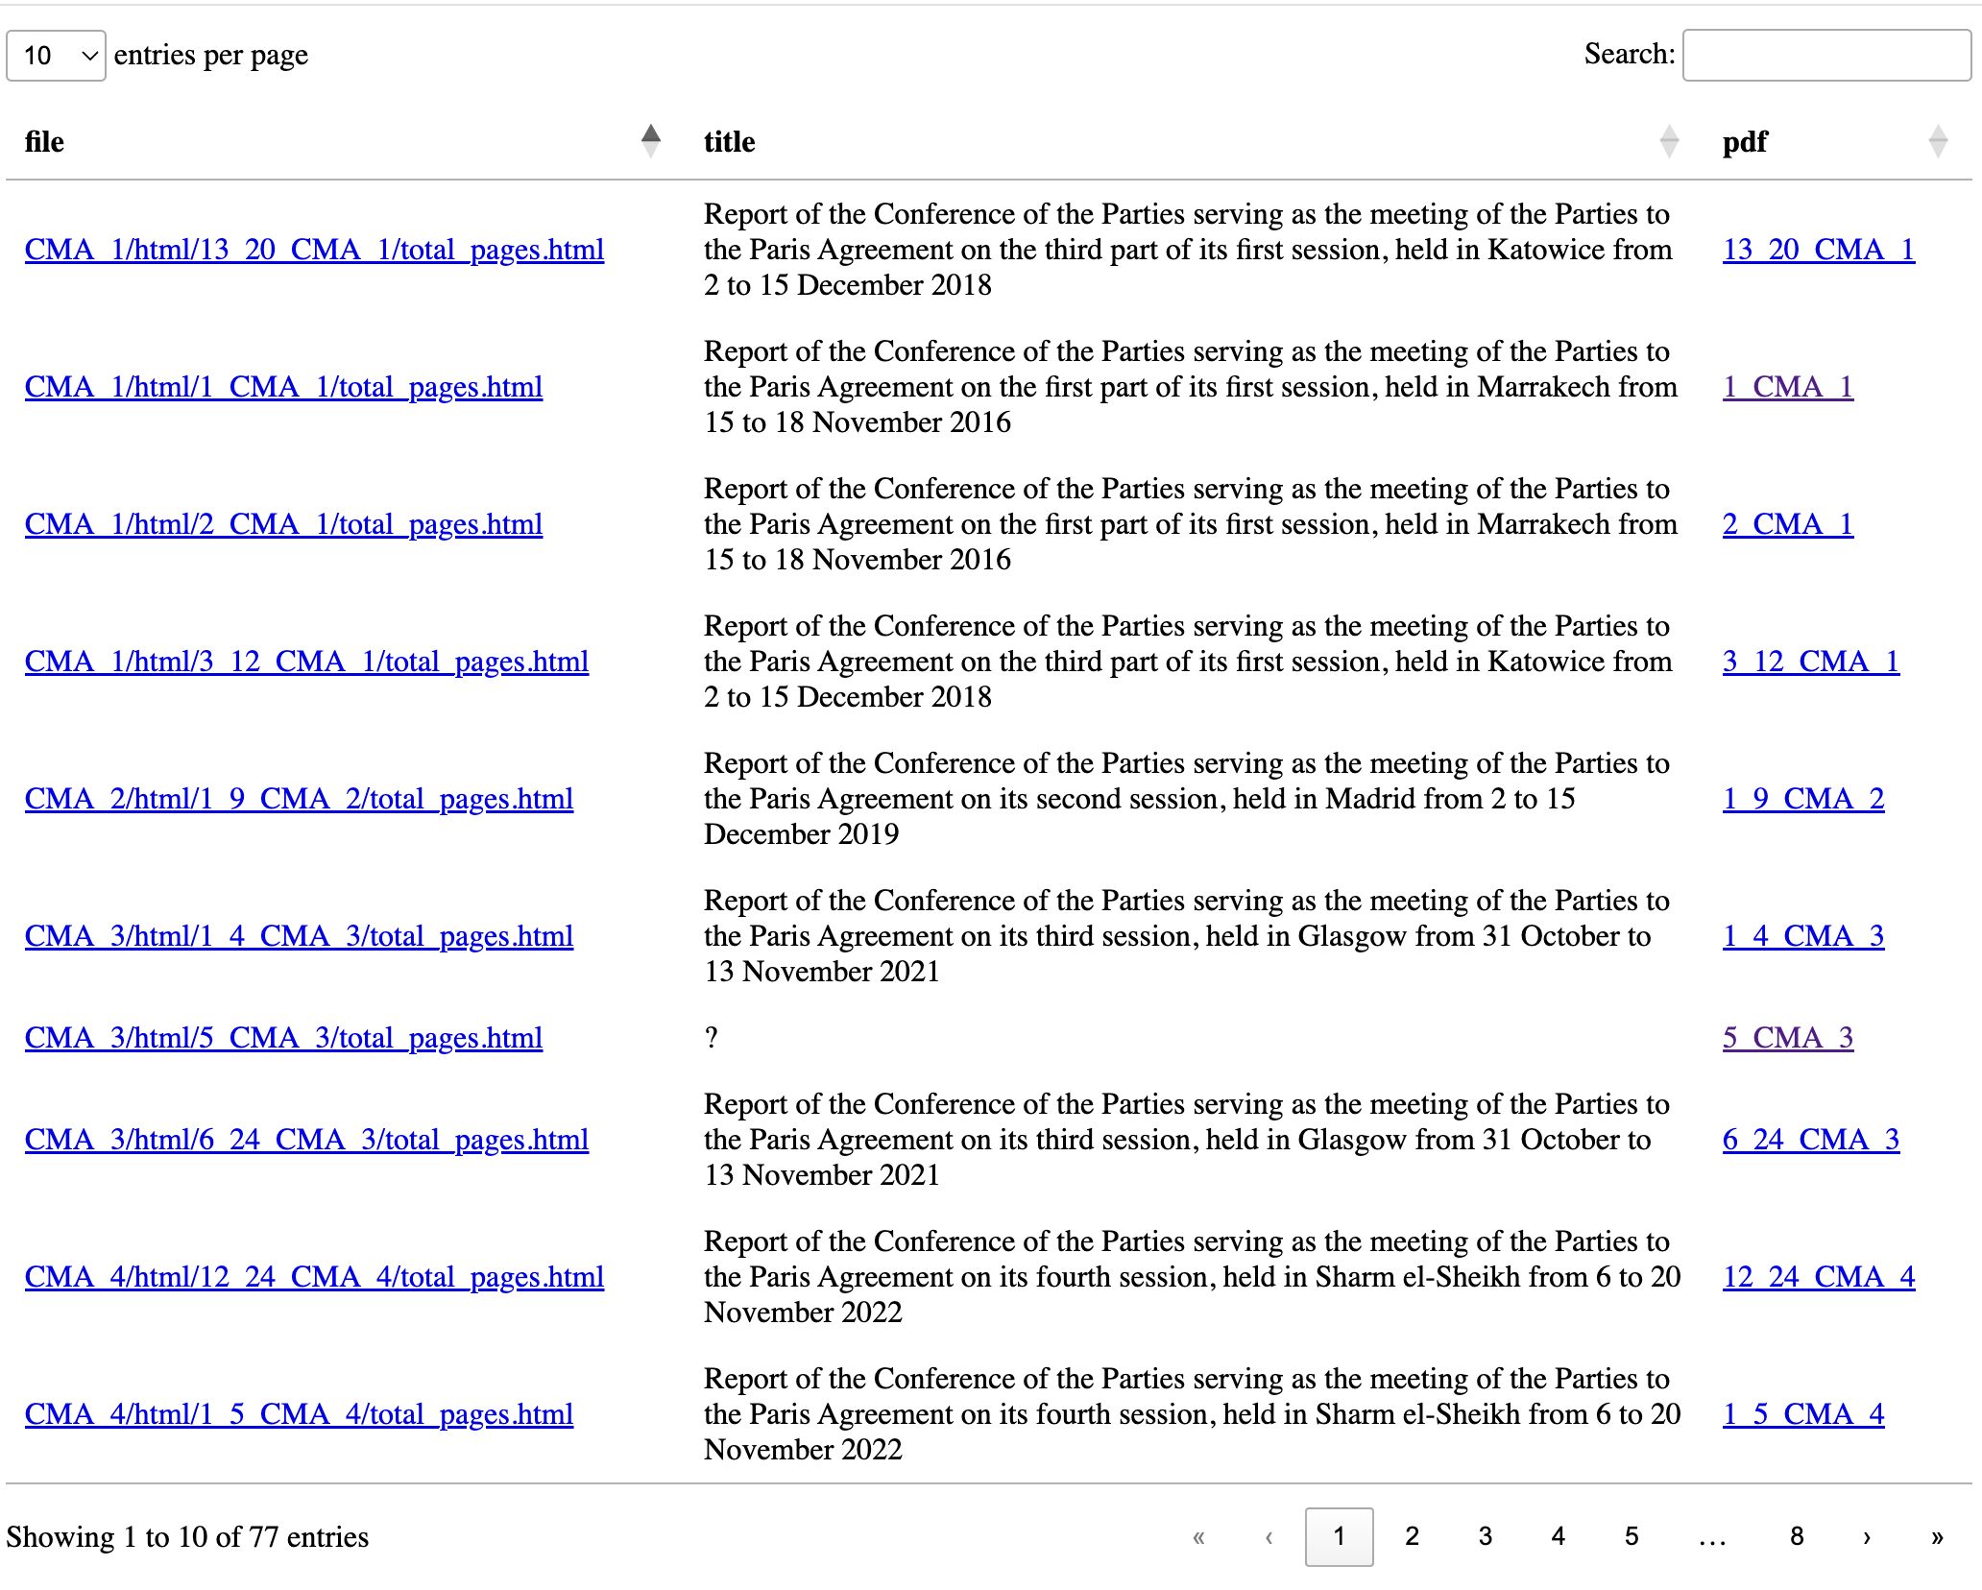
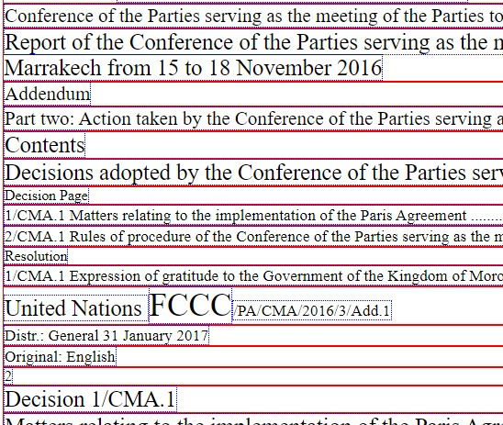
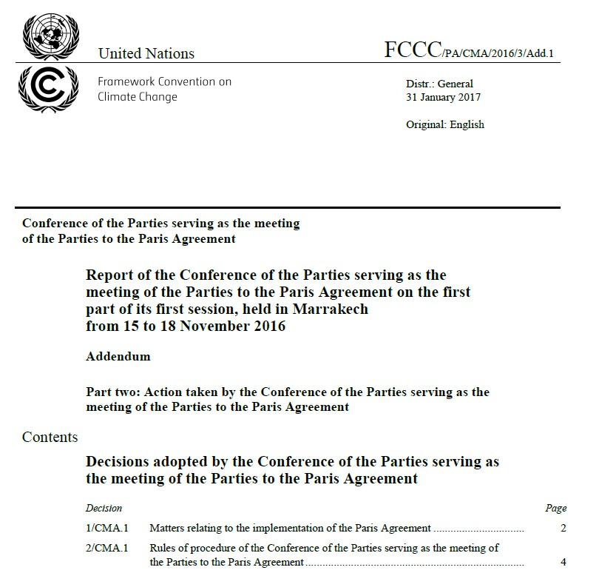
UNFCCC Documents (COP)
Datatables(An index for UNFCCC reports)
Reports in semantic HTML
COP Reports in PDF
Notes:
A formal record of each meeting. Lot of jargon both in terms of identifiers and termniologies. They describe the commitments and analysis parties have made each year.

Slide 14
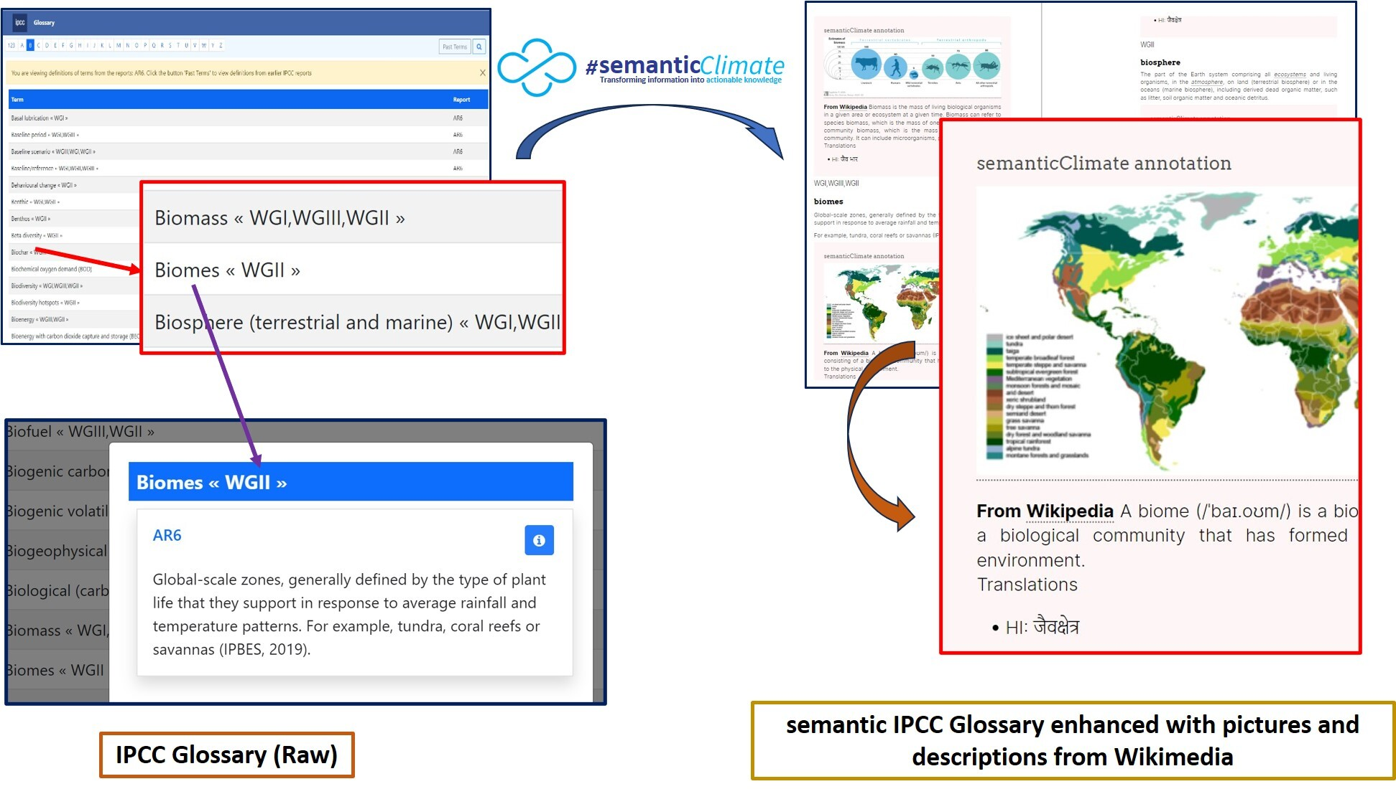
IPCC Glossary (5-Star)

Slide 15
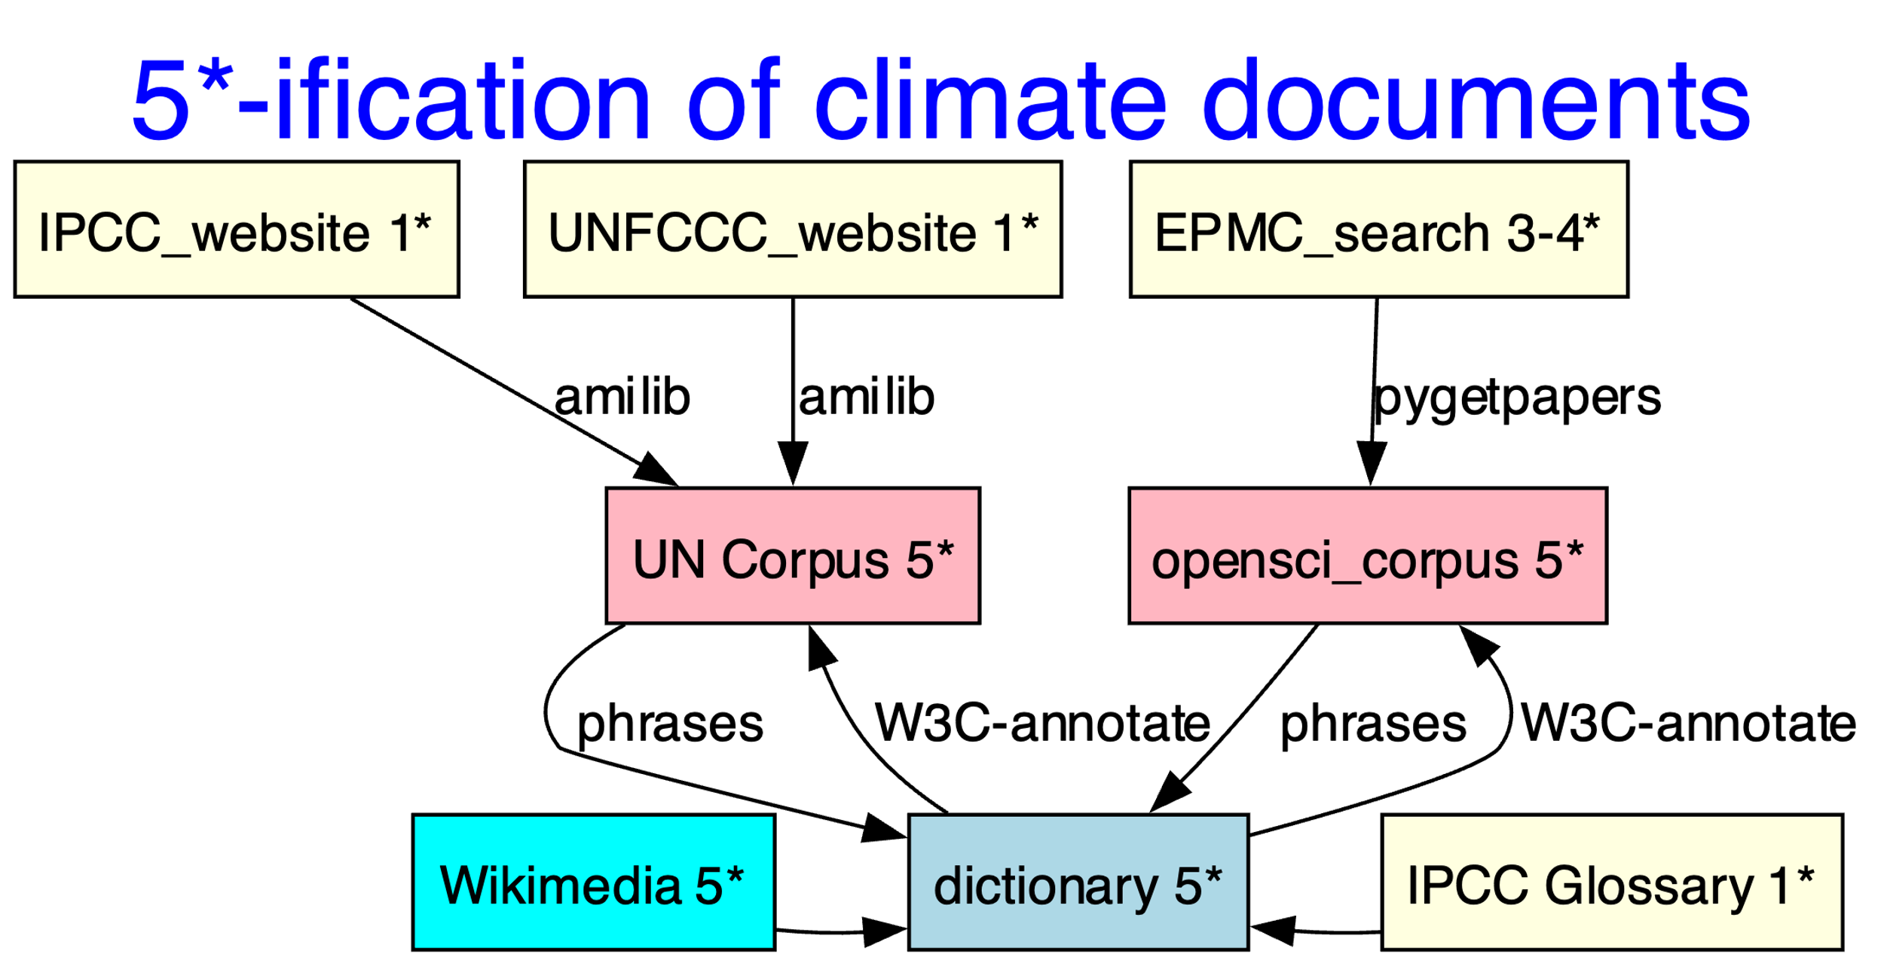
#semanticClimate builds Free and Open-source Software to create Linked Open Documents (5-star)
docanalysis
Notes:
We built a 5-starification “engine”. Climate documents are one star from the UN and 3 star from EPMC. We convert them into consist 5 star documents and dictionaries with the help of dictionaries.

Slide 16
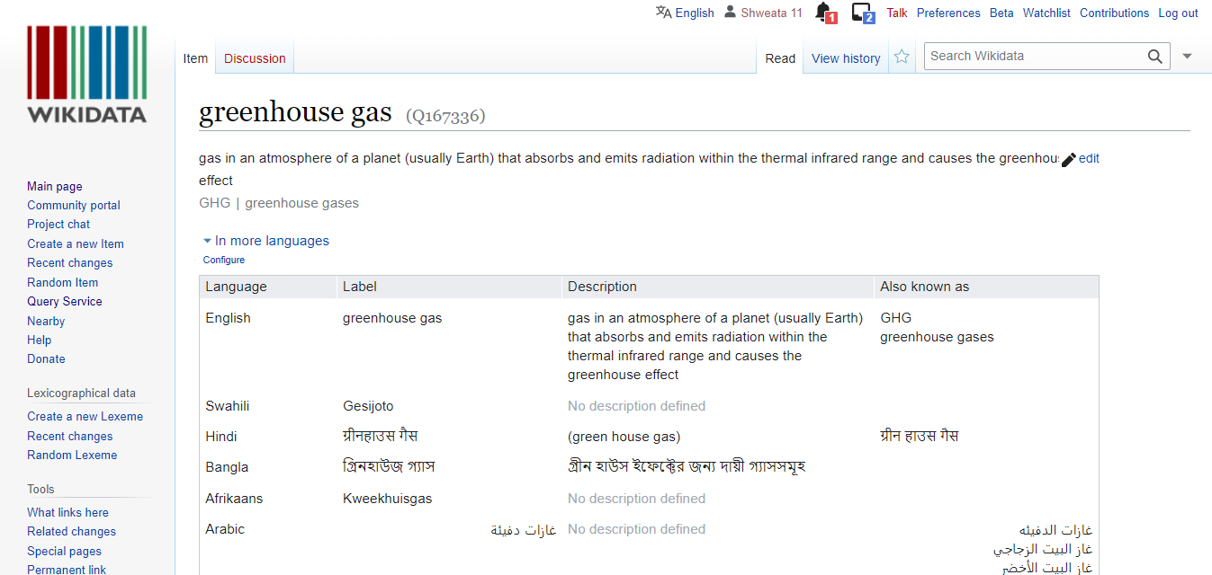
Dictionary
<entry name="VRE" term="Variable Renewable Energy" wikidataID=“Q7915732”/>
<entry name=“NDC" term=“Nationally Determined Contributions" wikidataID=“Q20051297”/>
<entry name=“GHG" term=“Greenhouse Gas" wikidataID=“Q167336”/>
Different languages!

Slide 17
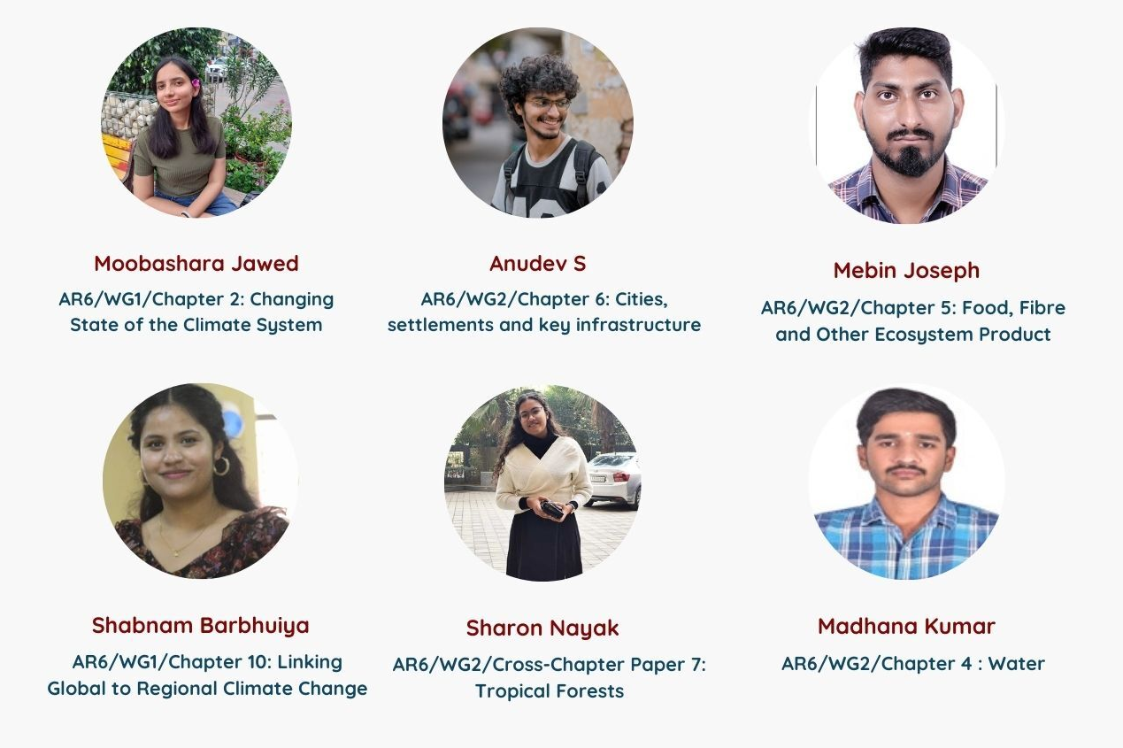
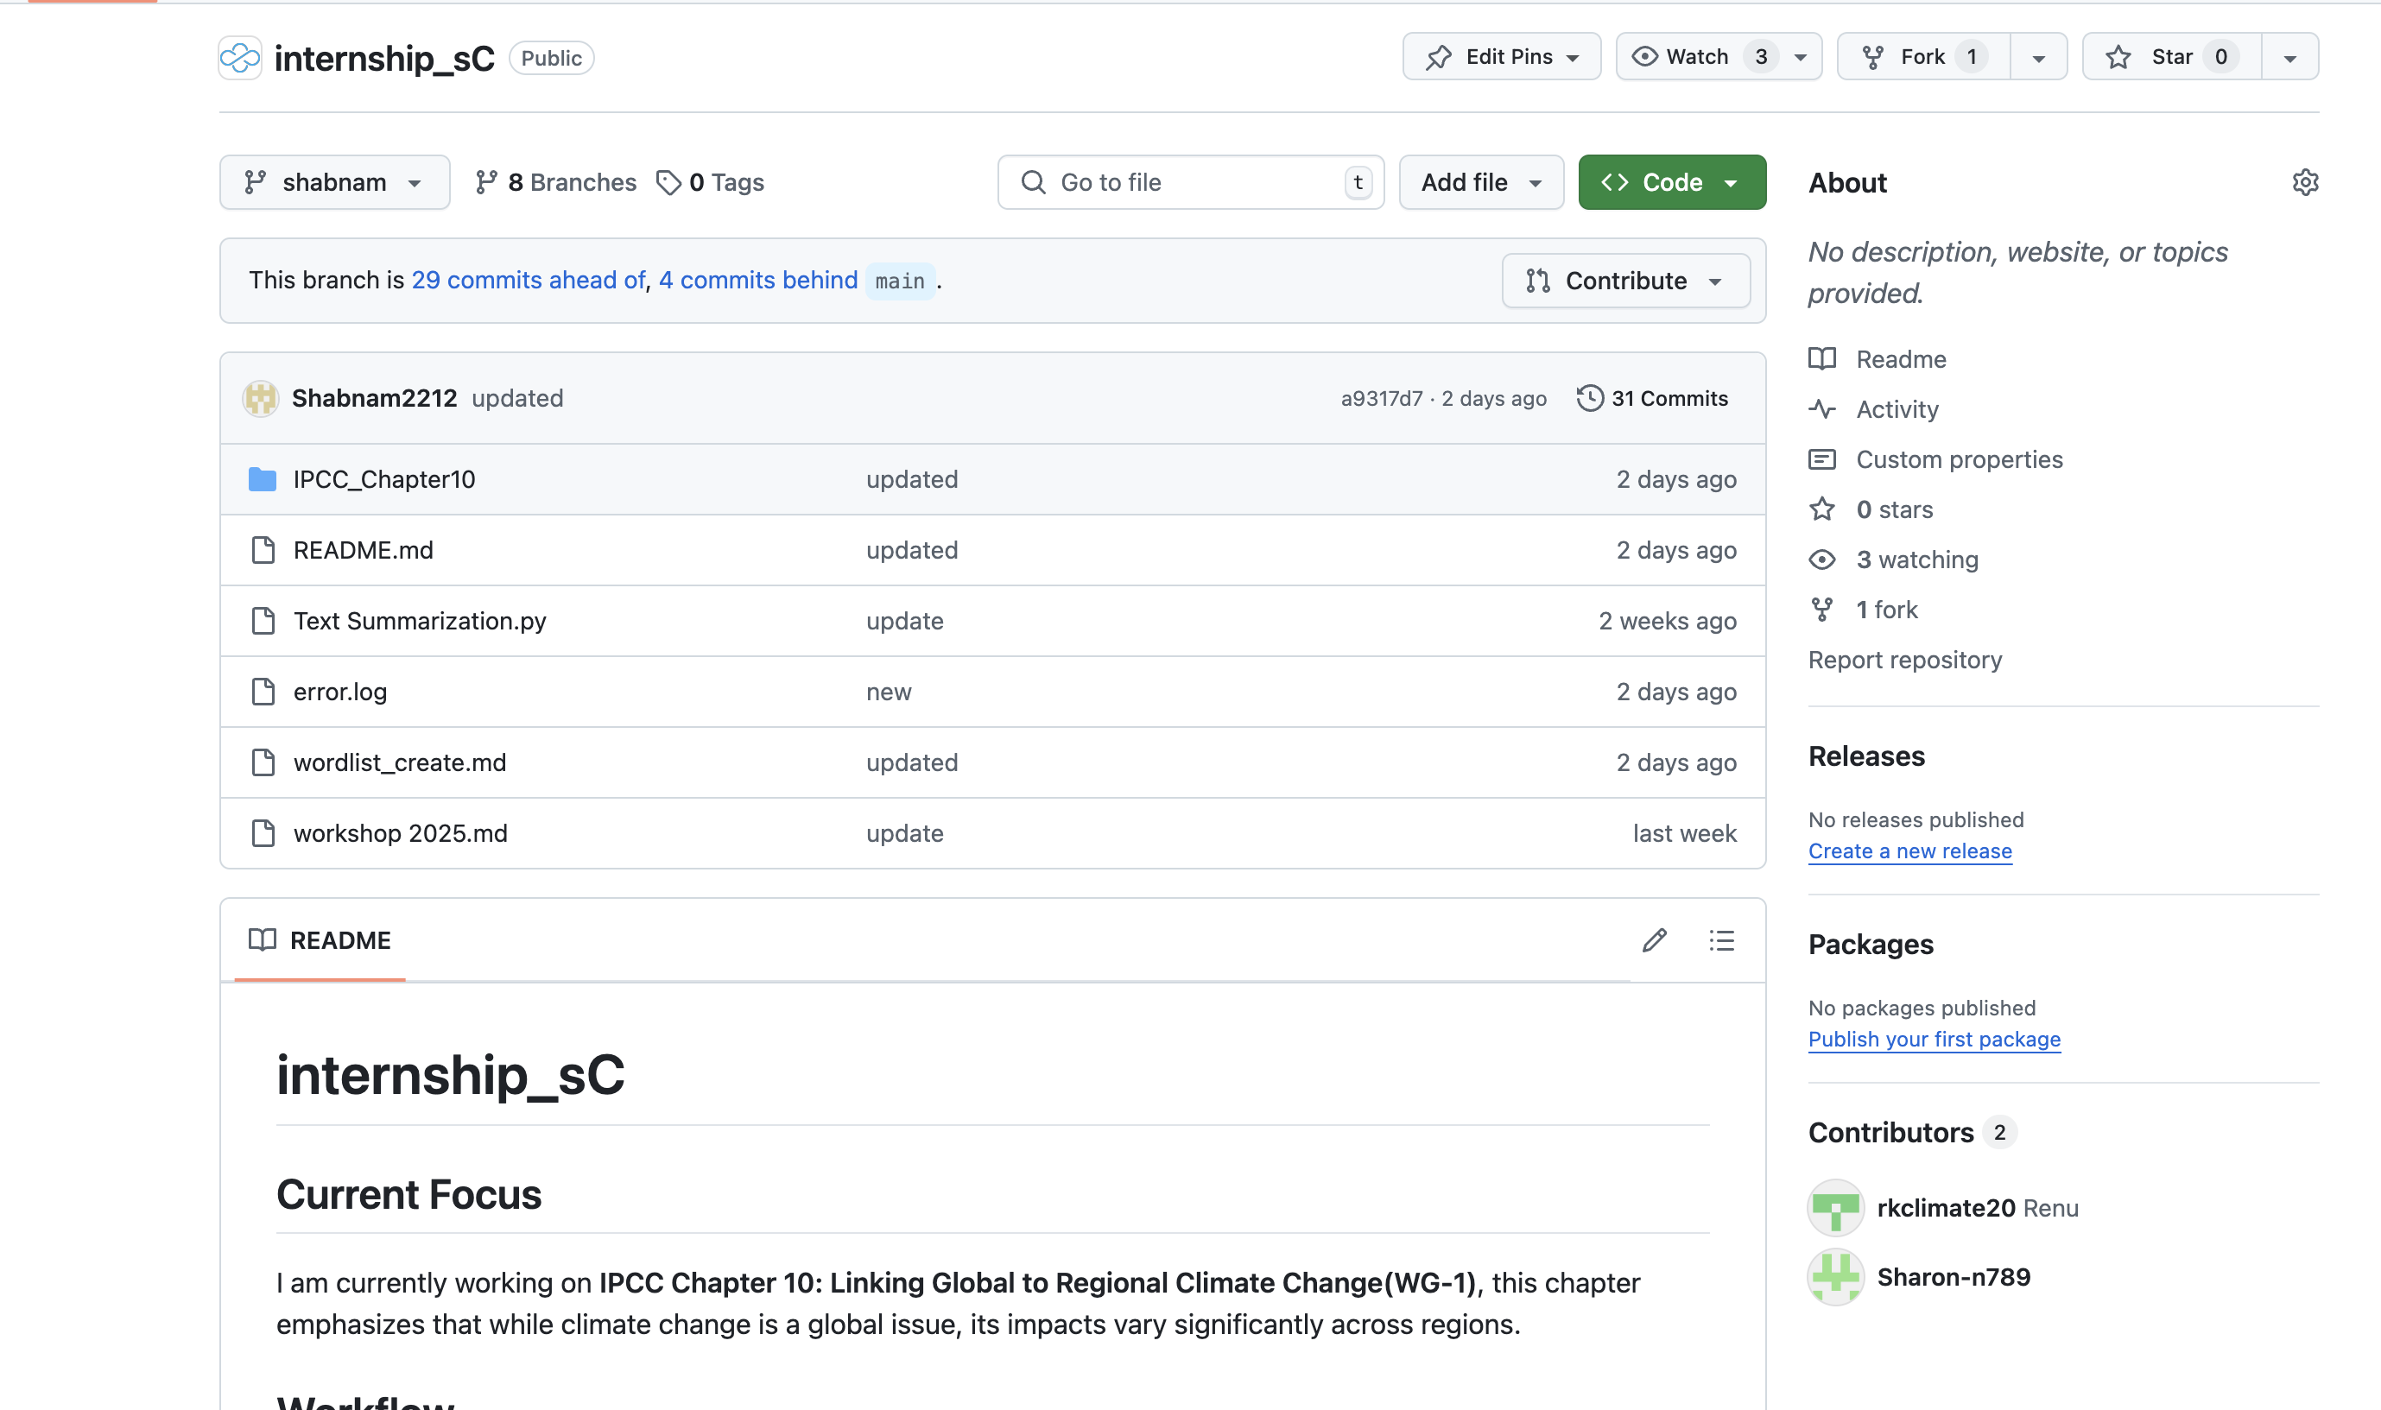

How We Work

Slide 18
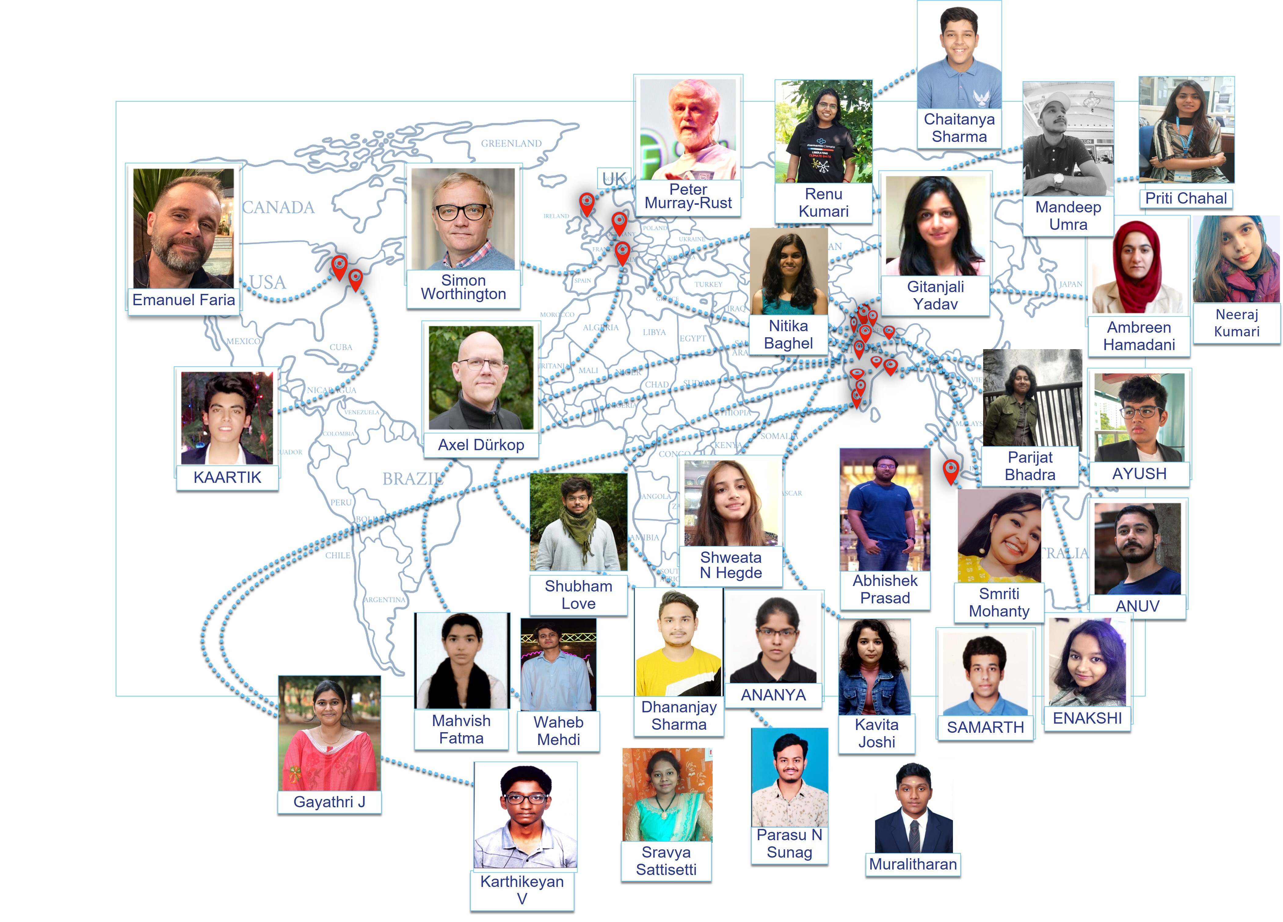
Sustainable Tech is created by Community
Youth Learning by Doing; Internship Programme hosted at the National Institute of Plant Genome Research (NIPGR)
100+ participants

Slide 19
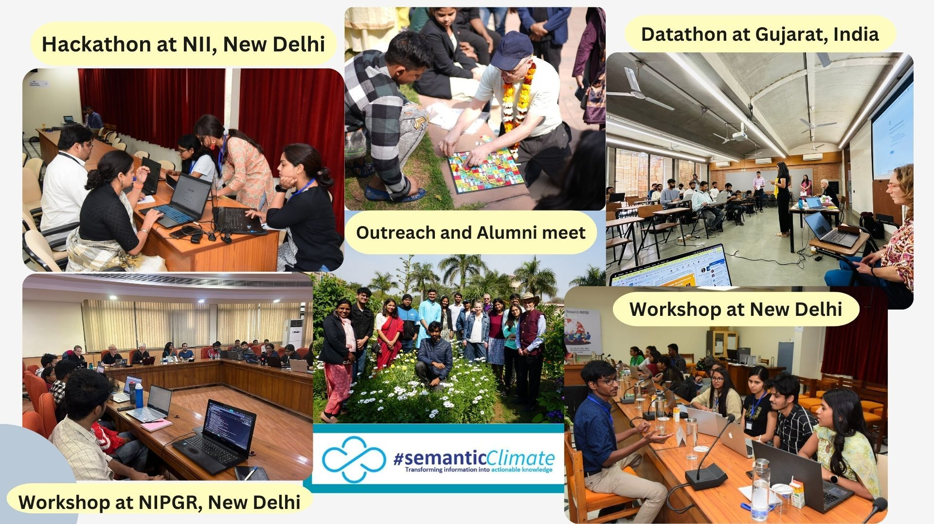
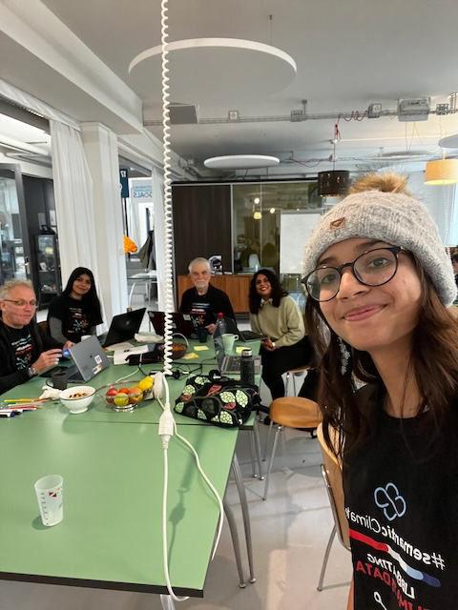
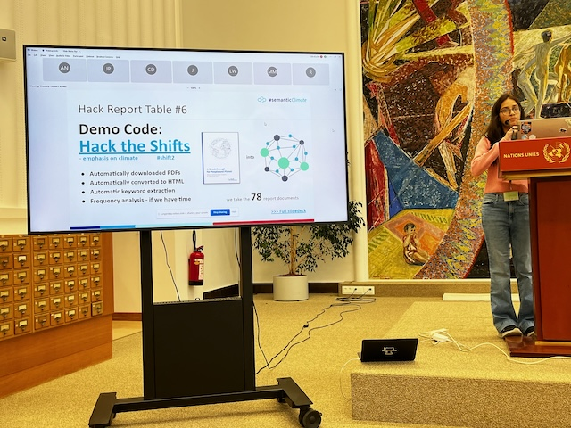
Community: Outreach
Outreach Organised
Outreach participated in
UNDatathon, UN Library Hackathon

Slide 20
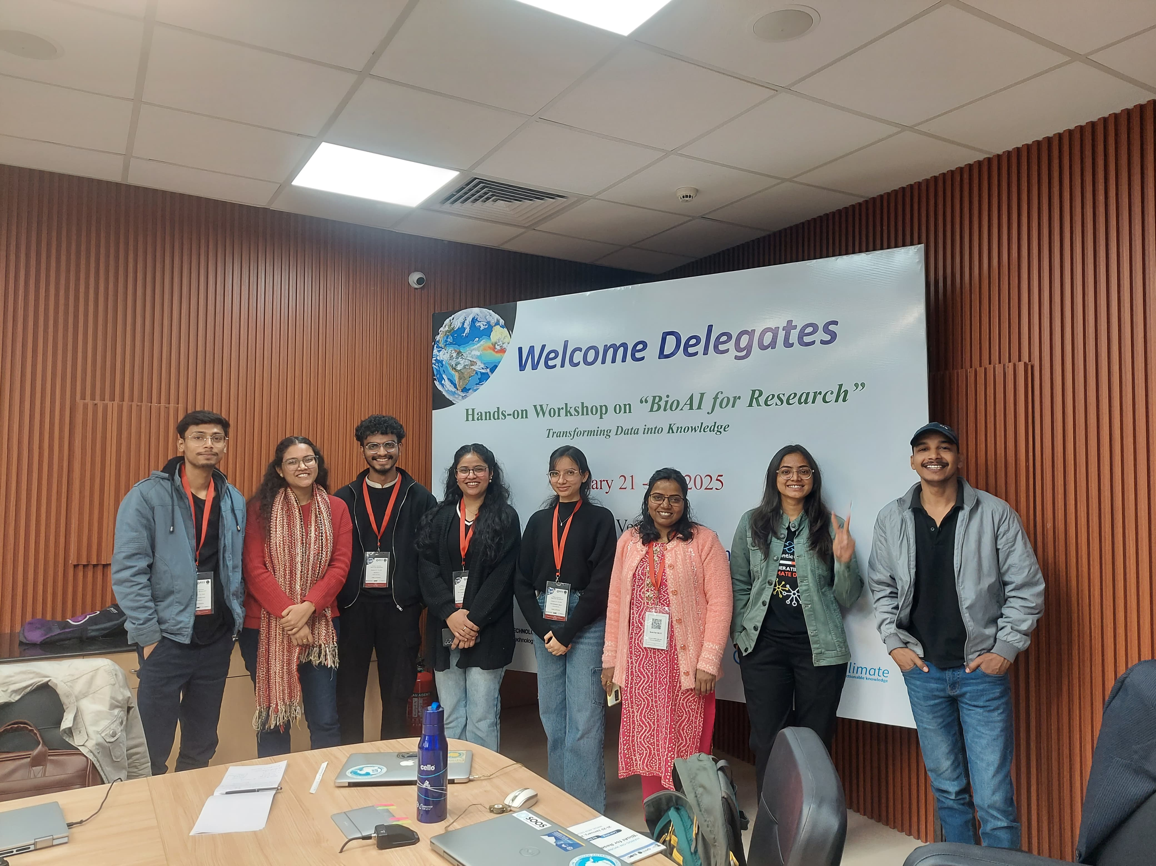
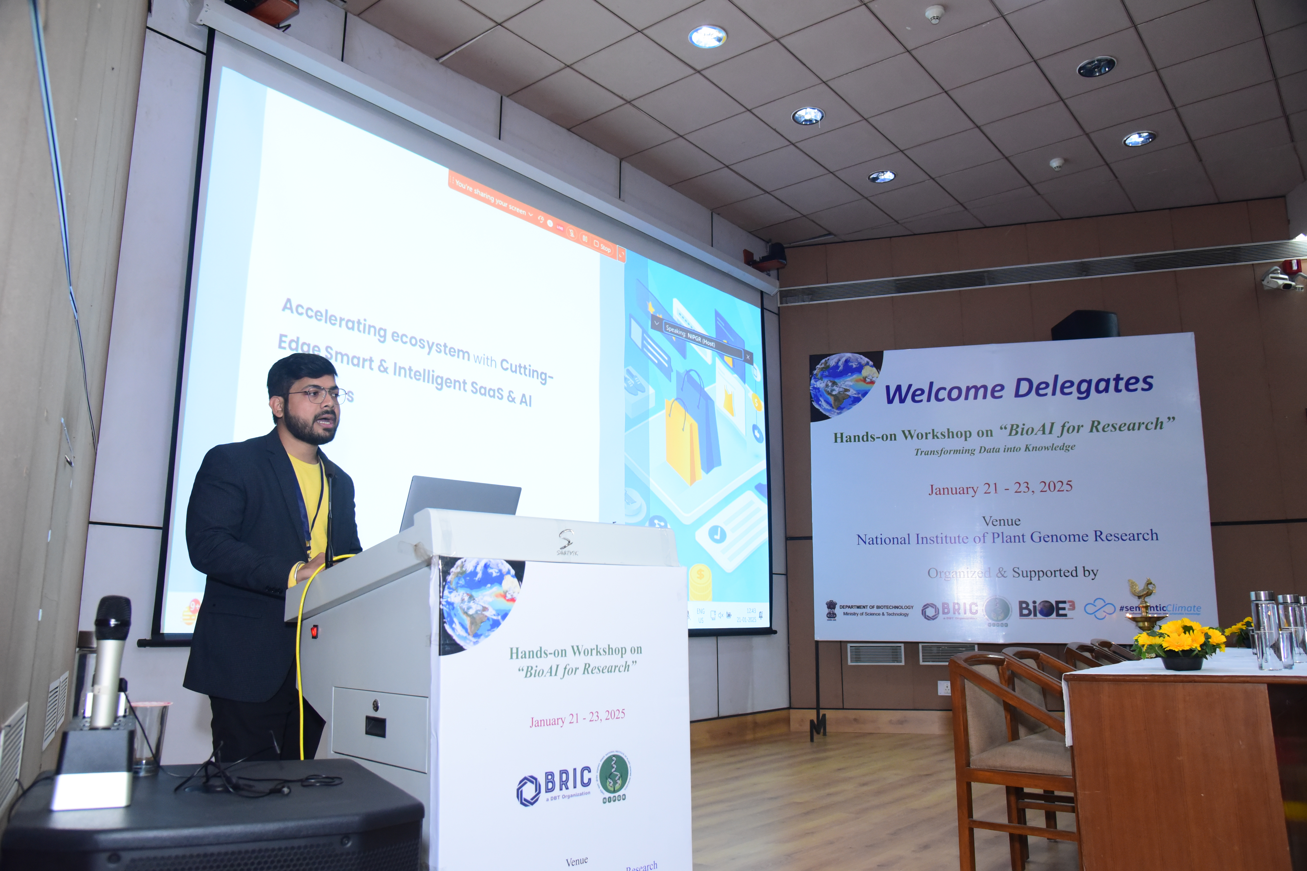
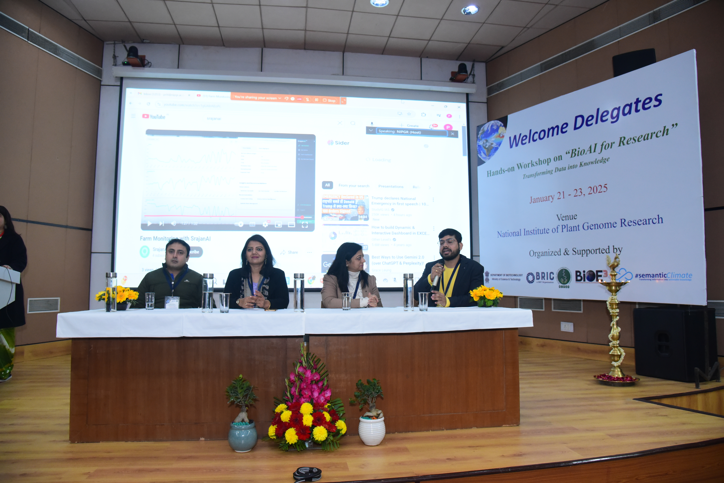
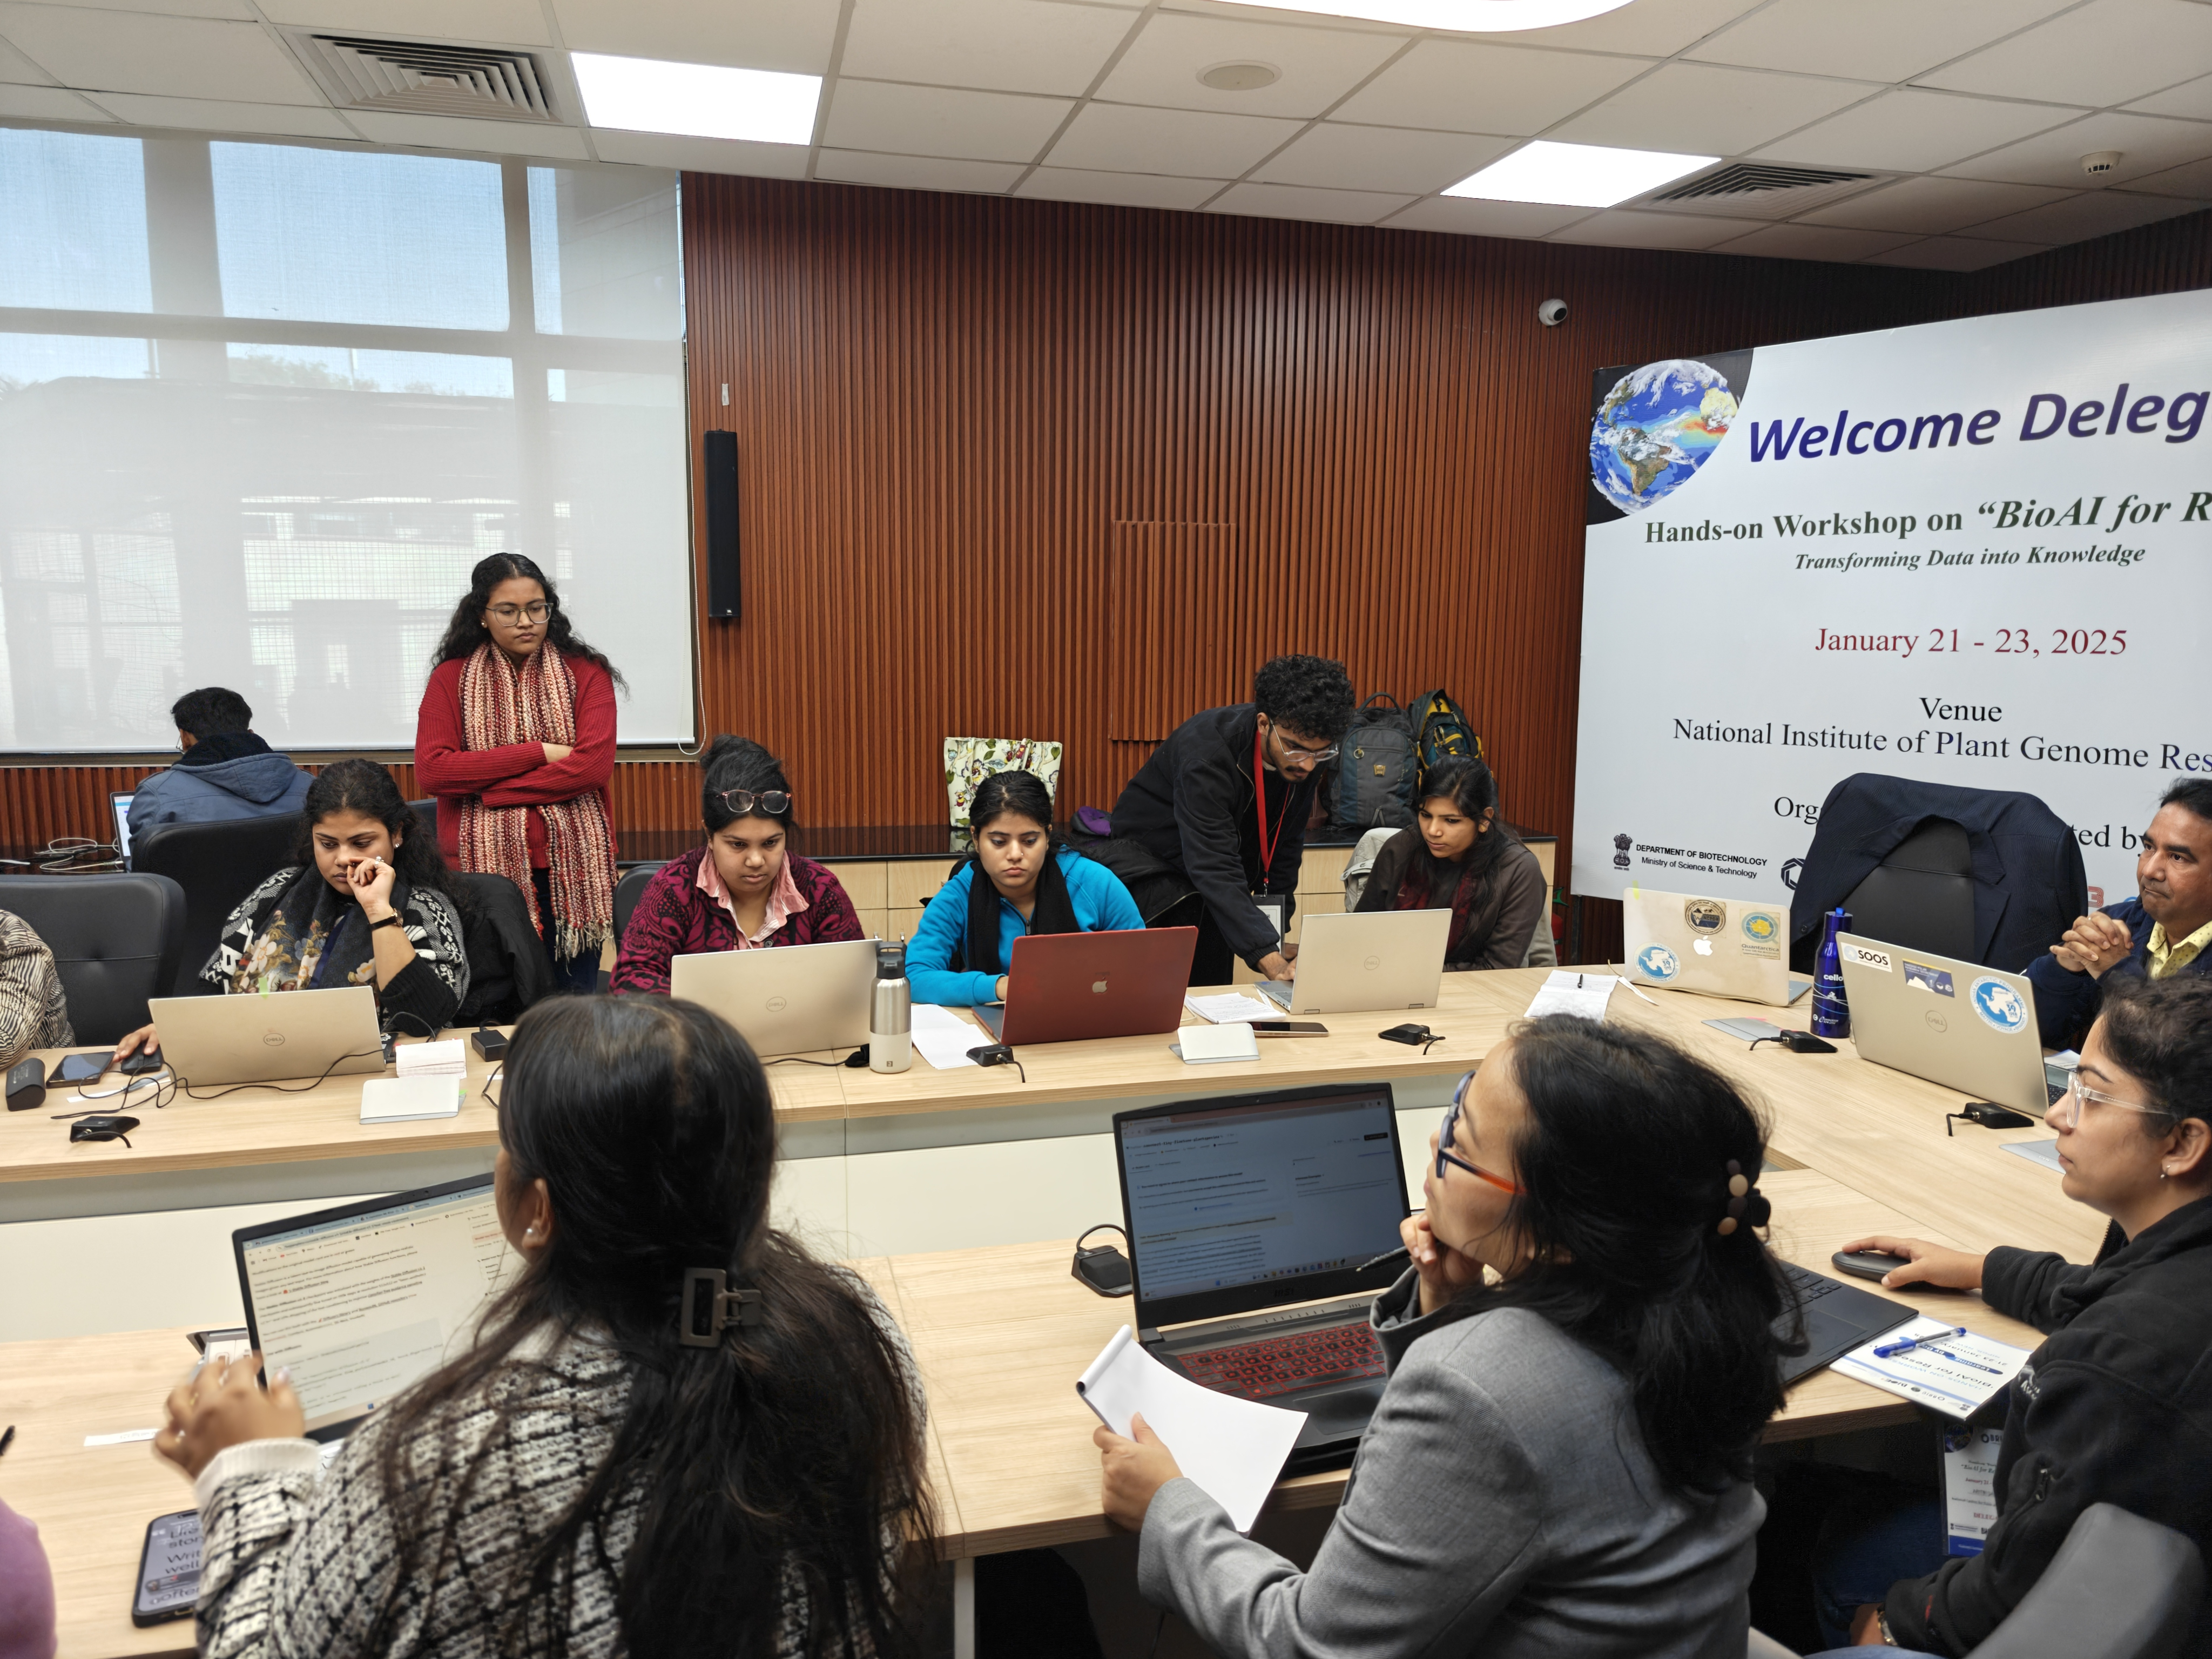
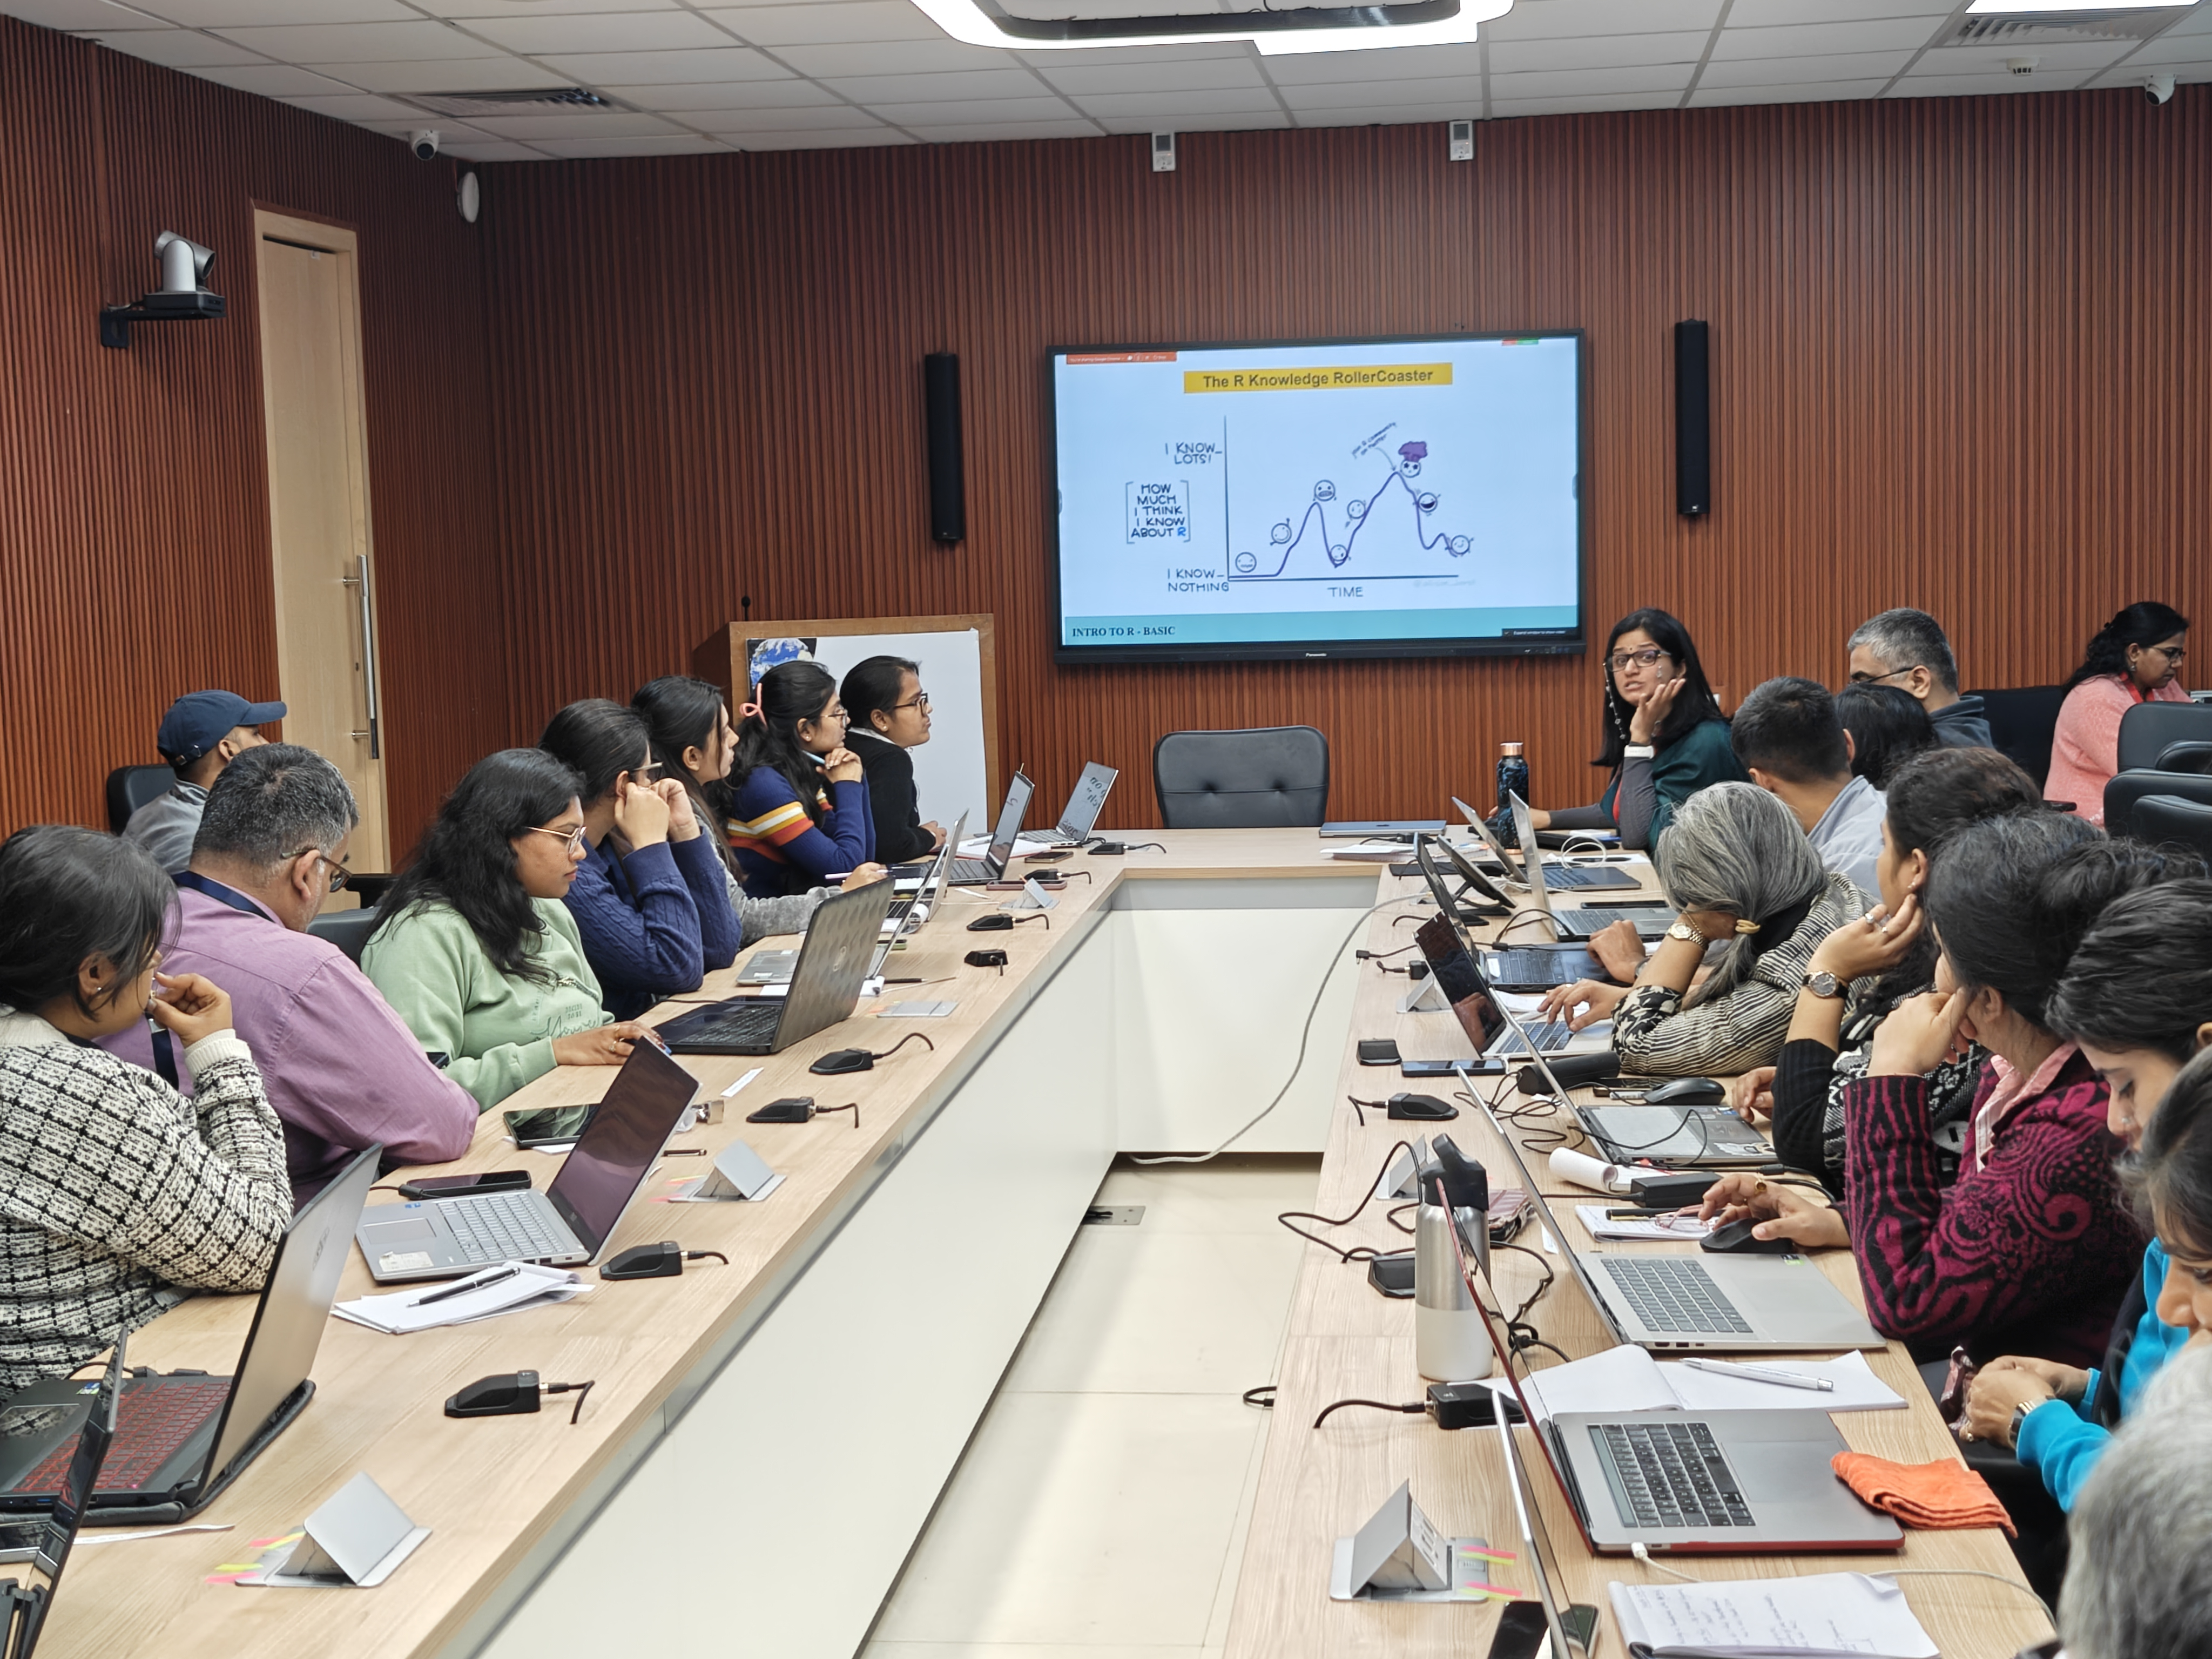
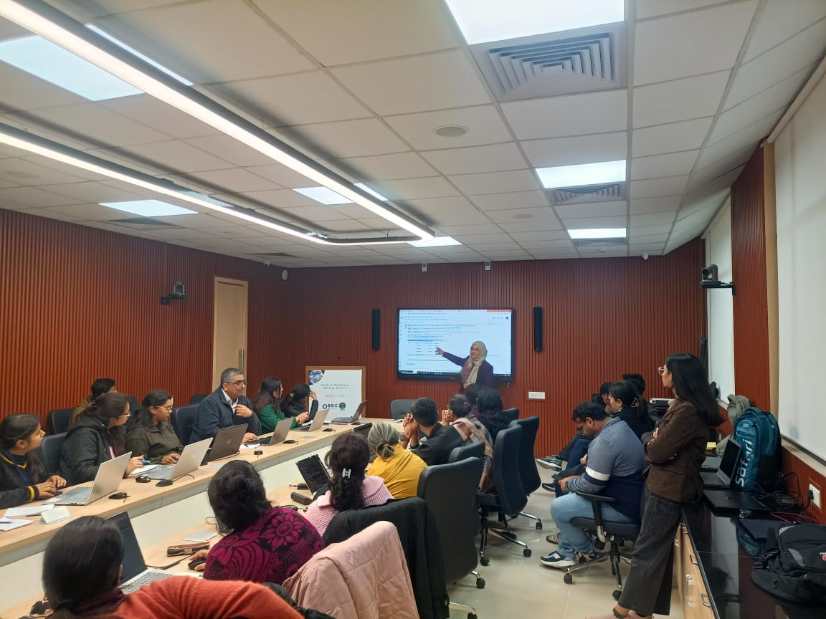
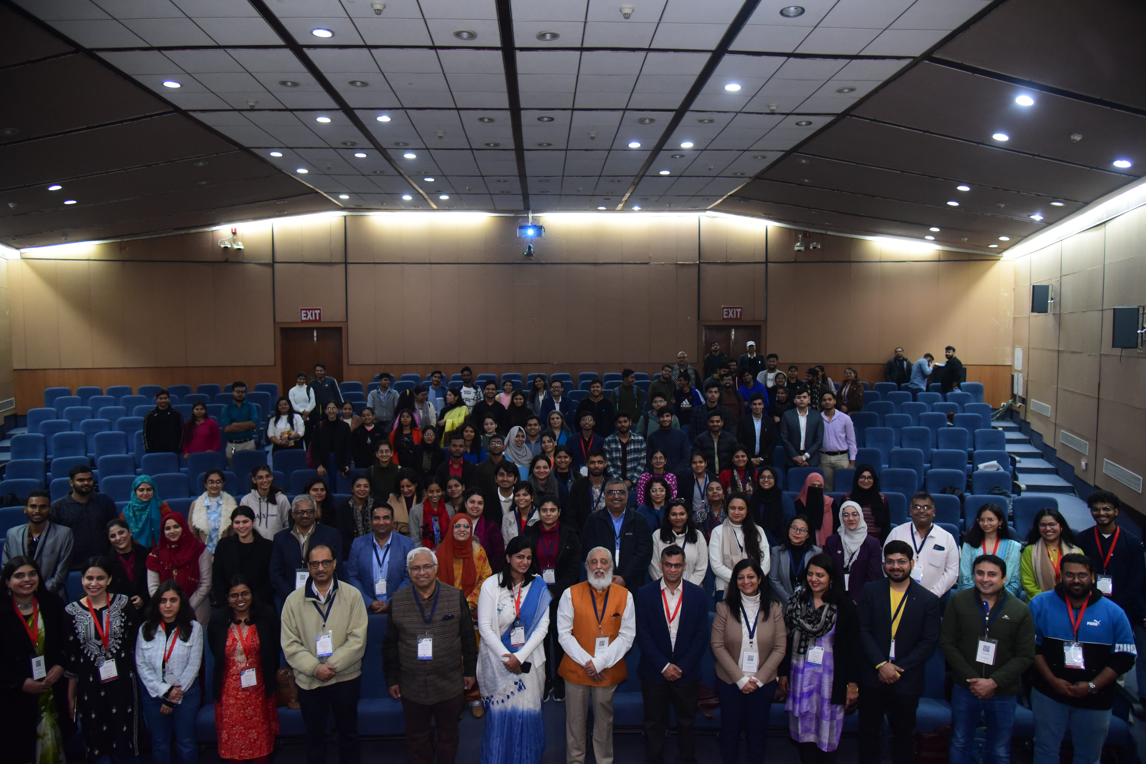
Hands-on workshop on BioAI for Research
~30 participants
Thirteen speakers shared valuable insights with the delegates.
RAG for summarizing IPCC paragraphs
Computer Vision for semantifying images

Slide 21
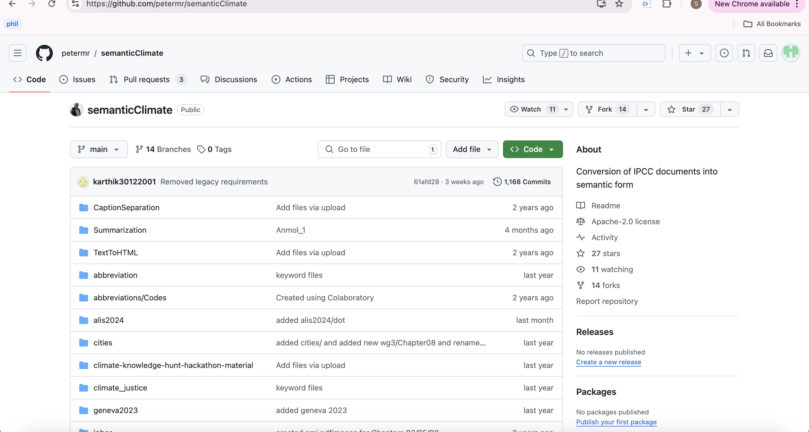
Useful Links
Tools amilib pygetpapers
Products IPCC Glossary Wikibase Instance Semantic IPCC corpus HTML Outputs
Outreach Event highlights

Slide 22
Let’s make climate knowledge 5-star (semantic)!

